Slide 1

Will the real CQRS please stand up Separating fact from fiction
Steven Hillaert
coaching software engineers

Slide 2

Before we start
Participate
Ask questions
Feedback

Slide 3
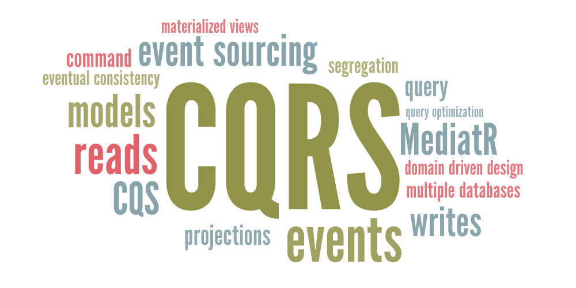

Slide 4
My own confusion
“Separating reads from writes”
But how could they not be separated? Turns out it’s pretty easy.
I was never sure if I was actually doing, or should be doing, CQRS

Slide 5
CQRS
is not an architecture
it’s a design principle
about logical segregation of responsibilities
that works in any layering scheme or architecture
and can’t be implemented by a library

Slide 6
Some vocabulary
Command
Changes data, creates side effects, returns nothing.
Query
Returns data, creates no side effects, changes nothing.
Model
A cohesive set of data and (sometimes) behavior.
Notes:
Command
Query
Model
This is the most difficult one to explain. Models are everywhere. We have database model, data model, entity model, event model, dto’s, request and response models for api’s, domain models. The list goes on.
Even popular patterns use models, MVC, MVP, MVVM. But does anyone ever explain what that model actually is? No, because nobody knows. ☺
I make people cry during interviews when I ask to explain “the model” part of those acronyms.
My definition: a model is a cohesive set of data, that sometimes also has behavior.

Slide 7
CQRS
Command
Query
Responsibility Segregation
Notes:
Explain segregation

Slide 8
In the beginning… CQS
Command-Query Separation
“Every method should either be a command that performs an action, or a query that returns data to the caller, but not both.”
- Bertrand Meyer (Eiffel)

Slide 9
CQRS takes it further
CQRS =
end-to-end CQS
separate, optimized models for reads and writes
no shared responsibilities or logic
Notes:
CQRS is basically CQS stretched across your whole application.
With models that fit their purpose, and with a strict boundary:
- reads never reuse write logic
- and writes never reuse read logic
CQS works at the method level: a method either changes something or it returns something. CQRS simply applies that same idea end-to-end. This means from the api all the way to data access)
It means we consciously split our read and write paths, and we let each side use models that fit their purpose. The write side focuses on business rules and invariants, while the read side focuses on returning data as efficiently as possible.
And most importantly: those two paths don’t share responsibilities or logic. Once you cross that line, you’re no longer mixing concerns, that’s where CQRS really starts.”

Slide 10
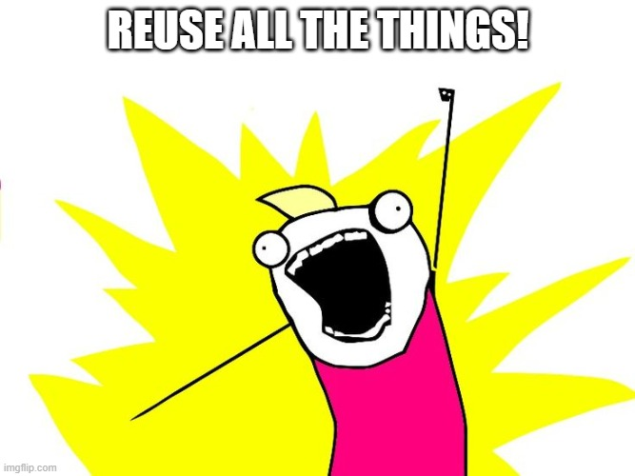
Why all this separation?
Isn’t reuse a good thing?
What about DRY principle?
Less code = less problems?
Notes:
We all love reuse, we all love DRY, and of course we’d all love fewer lines of code. And honestly — if your application is pure CRUD, that thinking holds up.
But the moment users actually start using your system, things change.
Suddenly a ‘simple update’ has validation rules, business constraints, workflows, approvals, calculations… and that nice, clean CRUD model starts breaking down.
That’s the moment where reads and writes drift apart, and it’s exactly why the separation in CQRS starts to make sense.

Slide 11
Reuse is good… right?
For simple CRUD, yes.
Unfortunately, most applications stop being simple CRUD the moment they’re in production.
Notes:
We all love reuse, we all love DRY, and of course we’d all love fewer lines of code. And honestly, if your application is pure CRUD, that thinking holds up.
But the moment users actually start using your system, things change.
Suddenly a ‘simple update’ has validation rules, business constraints, workflows, approvals, calculations… and that nice, clean CRUD model starts breaking down.
That’s the moment where reads and writes drift apart, and it’s exactly why the separation in CQRS starts to make sense.

Slide 12
Domain Driven Design made it click
My missing piece of the puzzle
💡 It’s the aggregate!
✅ Commands go through aggregates
⚠️ Aggregates are too big for queries
Notes:
Explain basic domain driven design => the domain model
Explain aggregate + code example
Commands go through aggregates. Queries don’t. That’s where the separation becomes obvious.
You don’t need DDD to use CQRS.

Slide 13
No segregation
User
Id
Name
Email
Address
Birthdate
IsVerified
reads
API UsersController
Business layer UserManager
Data access UserRepository
GET /users
GetAllUsers
GetAllUsers()
User
database
GET /users/5
GetUser
GetUserById()
User
POST /users
CreateUser
PUT /users/5
UpdateUser
writes
Notes:
Explained layered architecture.
The reuse of repositories.
The temptation to reuse functionalities in the same layer.

Slide 14
Segregation – on API
User
Id
Name
Email
Address
Birthdate
IsVerified
reads
API UsersController
Business layer UserManager
Data access UserRepository
Id, Name, Email
GET /users
GetAllUsers
GetAllUsers()
User
database
All details
GET /users/5
GetUser
GetUserById()
CreateUser
POST /users
User
CreateUser
UpdateUser
PUT /users/5
UpdateUser
writes
Notes:
Api already return optimized data for each query.
And also optimized input for each command

Slide 15
Segregation – on Business
User
Id
Name
Email
Address
Birthdate
IsVerified
reads
API UsersController
Business layer UserManager
Data access UserRepository
GET /users
Id, Name, Email
GetAllUsers
GetAllUsers()
User
database
GET /users/5
All details
GetUser
GetUserById()
POST /users
CreateUser
CreateUser
User
UpdateUser
PUT /users/5
UpdateUser
writes

Slide 16
Segregation – on Data Access
User
Id
Name
Email
Address
Birthdate
IsVerified
reads
API UsersController
Business layer UserManager
Data access
Dapper EF (projections) …
GET /users
GetAllUsers
Id, Name, Email
database
GET /users/5
GetUser
All details
Data access UserRepository
POST /users
CreateUser
CreateUser
User
UpdateUser
PUT /users/5
UpdateUser
GetUserById()
writes
Notes:
Notice the read side isn’t a repository. Repositories belong to aggregates on the write path. The read side is just data access — projections, SQL, or Dapper.

Slide 17
Segregation
Should we take it one step further?

Slide 18
Segregation – on database
reads
API UsersController
Business layer UserManager
Data access
Dapper EF (projections) …
sql
nosql
json
GET /users
GetAllUsers
Id, Name, Email
GET /users/5
GetUser
All details
Data access UserRepository
sql
CreateUser
POST /users
CreateUser
User
UpdateUser
PUT /users/5
UpdateUser
GetUserById()
writes

Slide 19
Segregation – on database
❓How do you sync?
☢️What if the sync isn’t working?
🚨Physical separation is really hard
💡CQRS is a logical separation, not physical
sql
nosql
json
sql
Notes:
Physical separation is not CQRS, it’s a big architectural decision.

Slide 20
So, where is the line?
What is actually required for CQRS?
Notes:
We’ve seen how far segregation can go. But what is actually required to call something CQRS?

Slide 21
Minimum CQRS
✔ Separate command path
✔ Separate query path
✔ Separate models
✔ Separate logic
❌ Separate databases
❌ Event Sourcing
❌ Eventual Consistency

Slide 22
MediatR != CQRS
✅MediatR simply makes segregation easier
⚠️But it doesn’t enforce or protect!
❌CQRS isn’t a library
Notes:
You can use MediatR and still be CRUD
Commands can mutate and return data
Queries can use domain entities
It’s not difficult to use MediatR and still have no segregation.

Slide 23
CQRS is architecture agnostic
✅ n-tier
✅ clean, onion, ports & adapters…
✅ vertical slicing
✅ (modular) monolith
✅ microservices
Notes:
CQRS lives inside architectures, not instead of them.
You can use it with any layering scheme or architecture.

Slide 24
CQRS and Entity Framework
✅EF just makes it too easy!
❌Entities don’t match read models
💡Queries need projections

Slide 25
Conclusion
✅ CQRS is logical segregation of responsibilities.
→ easy to implement
⚠️ CQRS can enable physical segregation and more advanced design and architecture.
→ hard to implement

Slide 26

Questions?

